Slide 1
Deliverable 3
Boston Budget Team D:
Ruoxi Jin, Logan Neishloss, Qicheng Cao, Shreyas Sudarsan, Priscilla Nguyen

Slide 2
Motivation, Goal, and Background
Background: every year the City of Boston allocates funds for both operating and capital budgets.
⇒ Goal:
to help provide insight on questions like: how has funding of different departments and geographies or other attributes change over time? How is this impacted by age demographics?
⇒ Motivation:
To analyze how the City of Boston's budget is allocated across different departments, neighborhoods, etc. and to identify trends in funded projects
⇒ Background:
https://www.bostonglobe.com/2023/10/01/opinion/affordable-housing-suburbs-senior-housing-zoning/

Slide 3
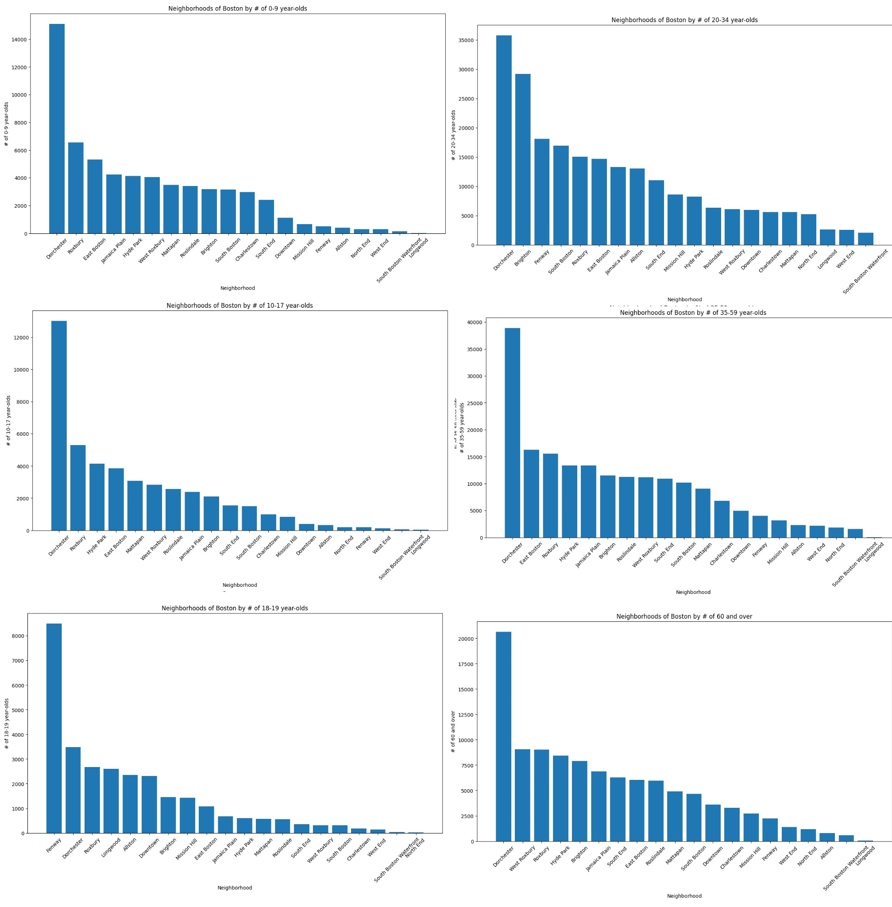
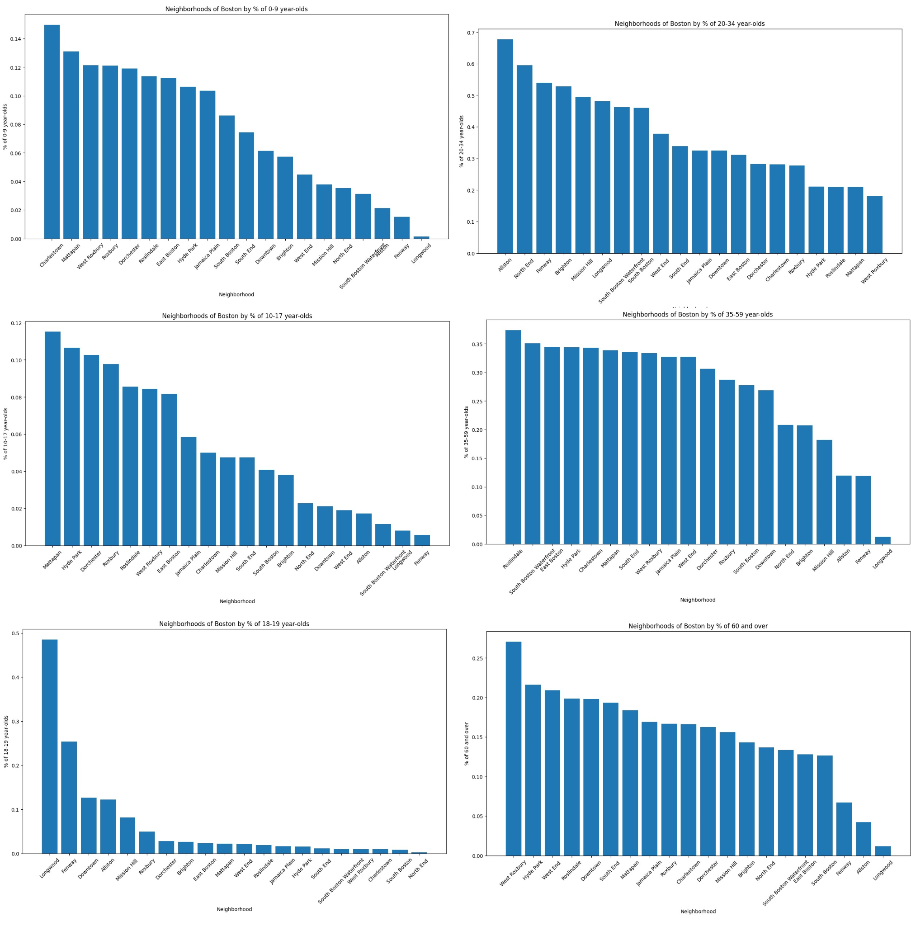
Progress for extension

Slide 4
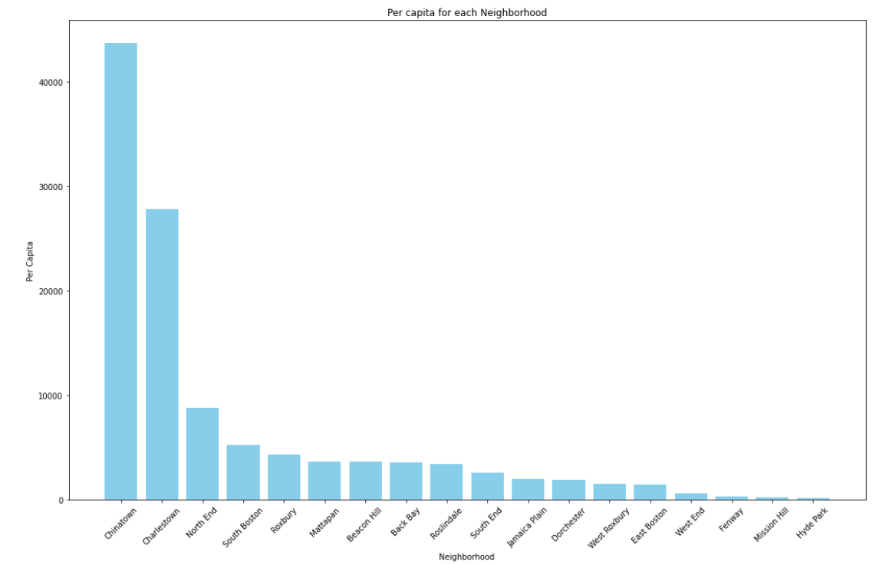
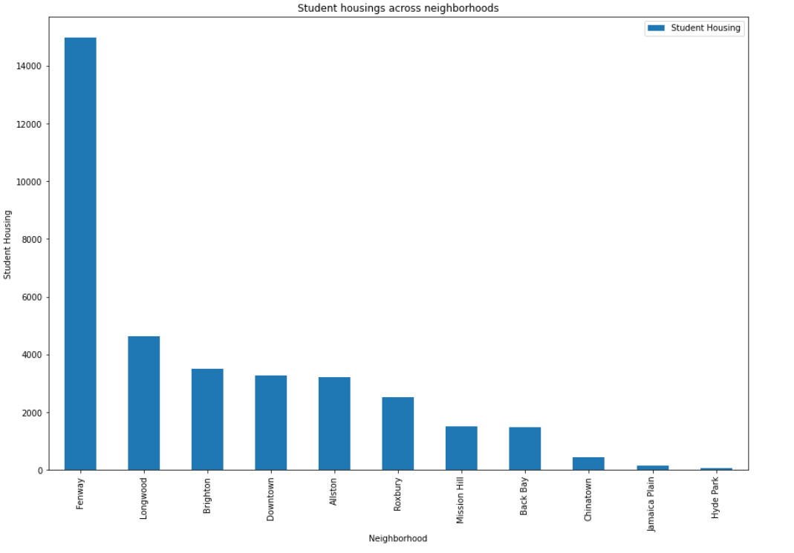
Per Capita and Student Housing for each Neighborhood

Slide 5
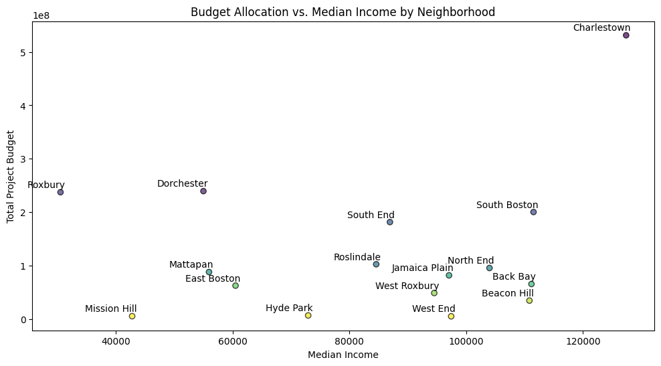
Budget Allocation vs. Median Income by Neighborhood

Slide 6
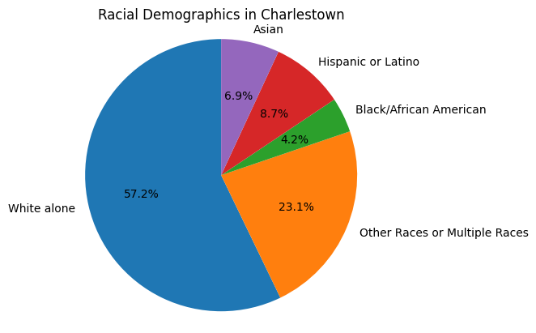
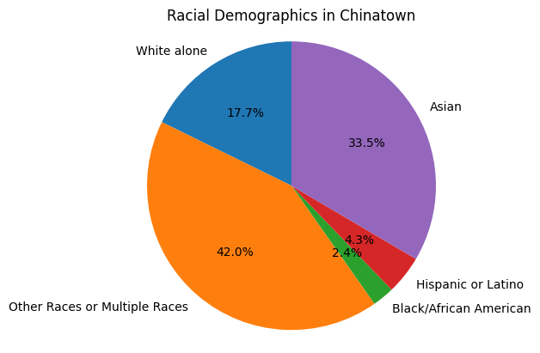
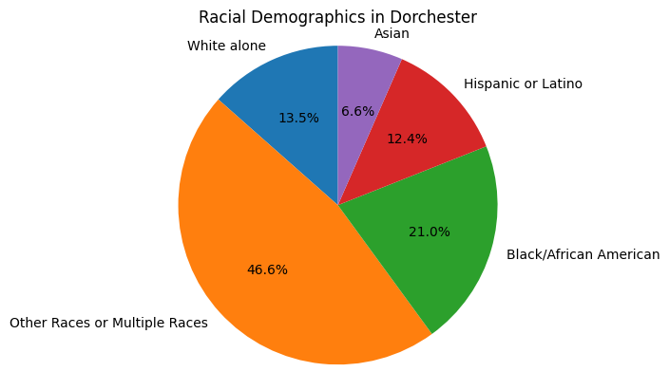
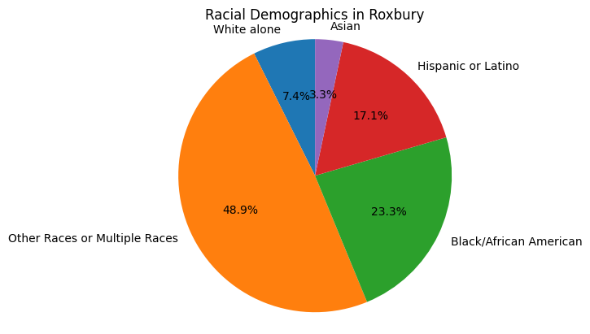
Racial Demographics in Neighborhoods

Slide 7
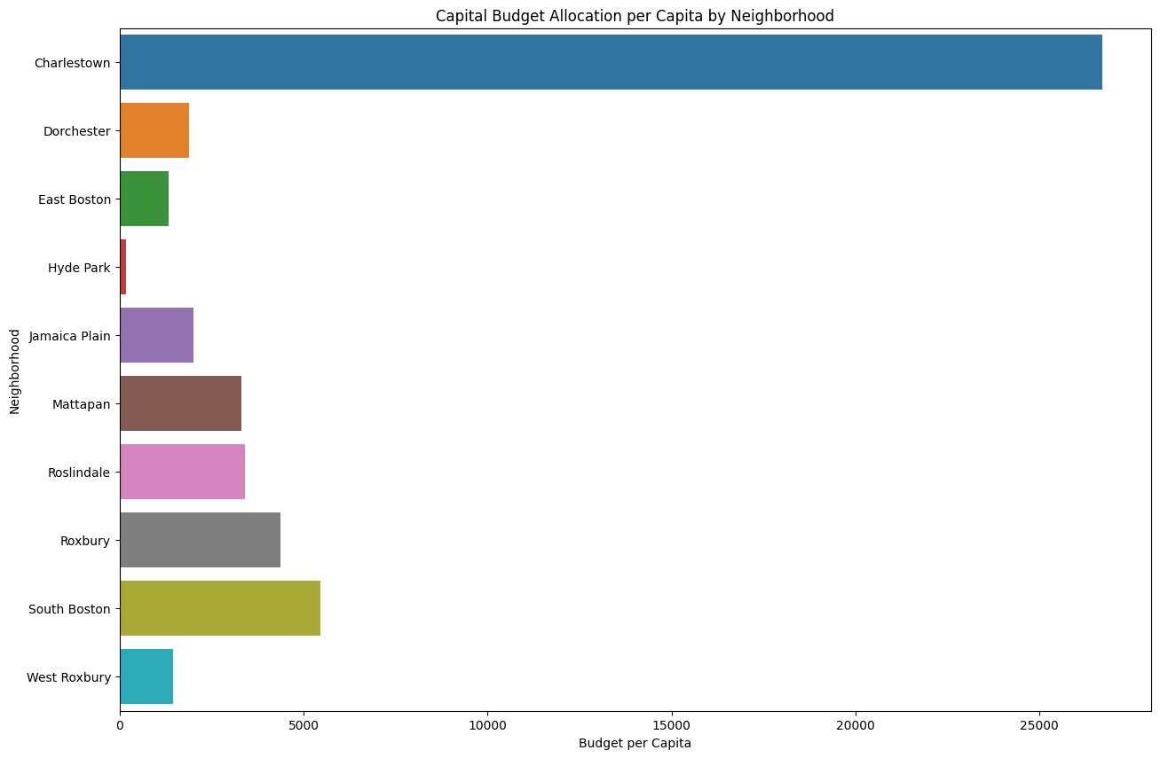
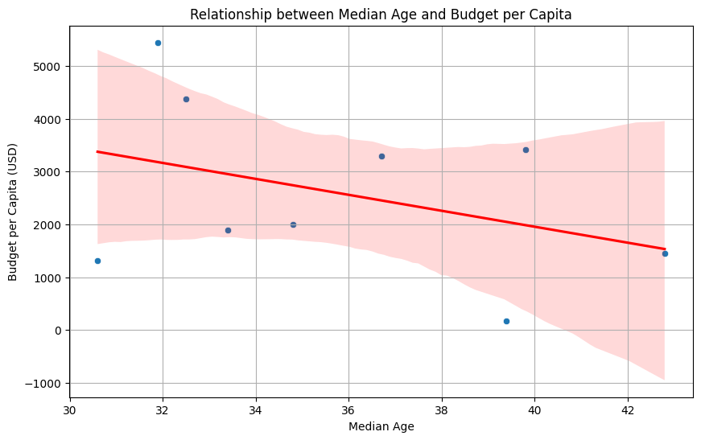
Relationship between Median Age and Budget per Capita

Slide 8
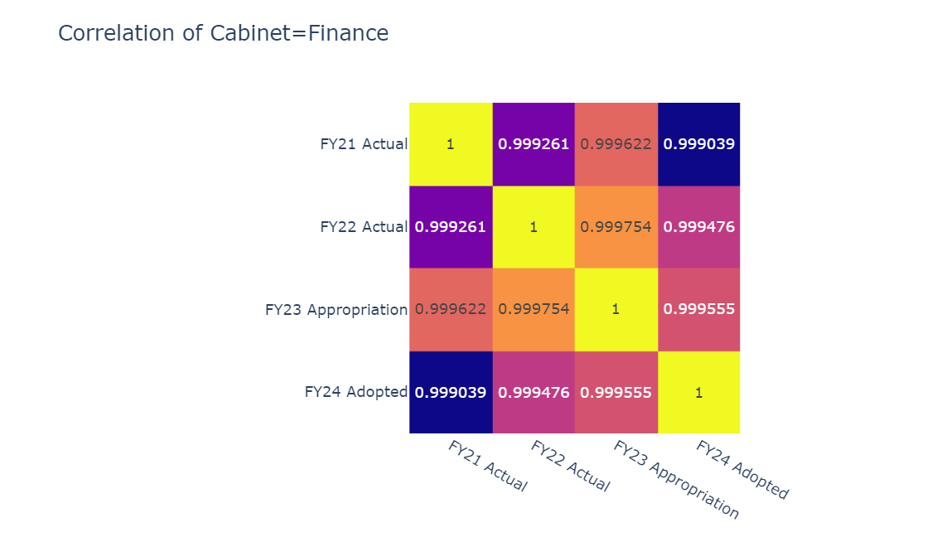

Slide 9
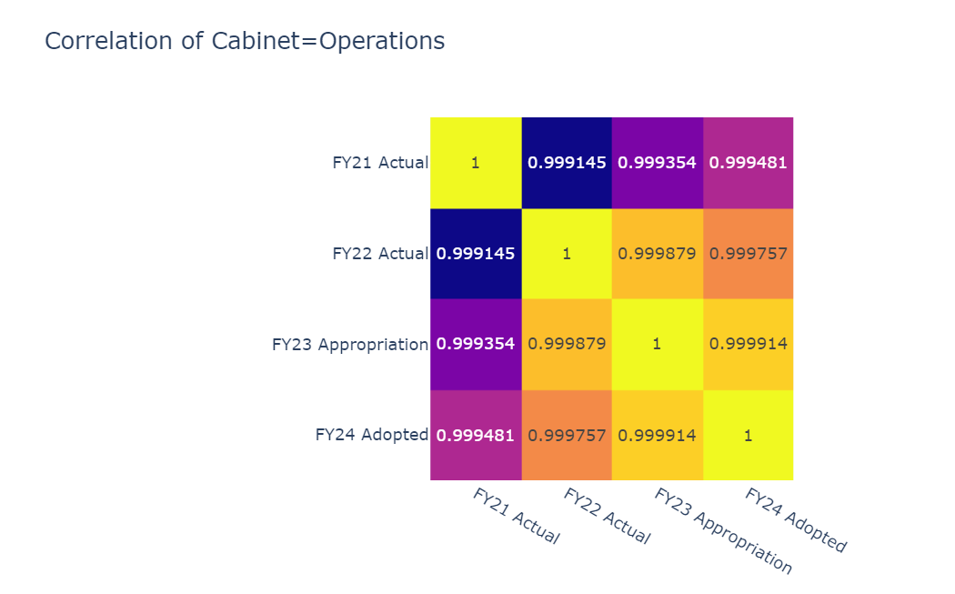

Slide 10
Individual contribution
Ruoxi Jin – Finished fixing revenue_2.ipynb by adding more analysis and fix image issues. Did preprocessing dataset since we got points taking off from Deliverable 2. Help with presentation PPT.
Logan Neishloss - EDA on datasets used for extension project. Research into new useful data sources to correlate with existing budget datasets.
Priscilla - Examined racial demographics in neighborhoods and the relationship between budget allocation and median income in each neighborhood.
Qicheng Cao - ​​Analyzed the correlation between median age and budget per capita by different neighborhoods in Boston.
Shreyas Sudarsan - Visualized the per capita income and student housing distribution for various neighborhoods in Boston. Research into more datasets that might help uncover more correlations to the existing budget data.

